Slide 1
Anatomy of a Software House

Slide 2
Introduction(The Company)
A Hypothetical Company
Syniad Software Ltd was founded some ten years ago by four friends and colleagues who still own most of the shares in the company;
All four are members of the Board of Directors, along with two others who were recruited later.
The company specializes in the production of bespoke software(software solution created for a specific user) for clients who demand work of high quality.
Demands technologies recently developed – also demands of creating new technolgies
Syniad’s head office is in London. Other offices in Manchester, Delft, Netherland

Slide 3
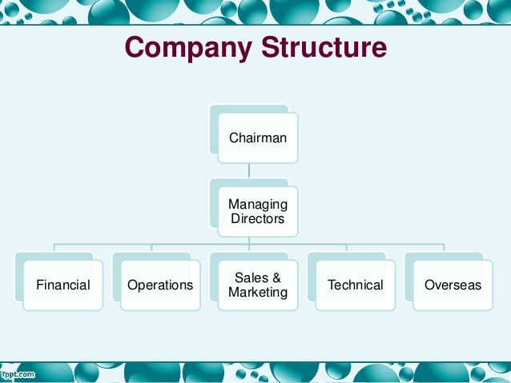
Company Structure

Slide 4
Operation Director
The Operations Director is responsible for all the revenue earning operations of the company
He is also responsible for ensuring that the utilization of revenue earning staff is kept at a satisfactory level(no lazy workers, no under utilization)
Resources are available to carry out the projects that the company wins
The personnel reports to him.

Slide 5
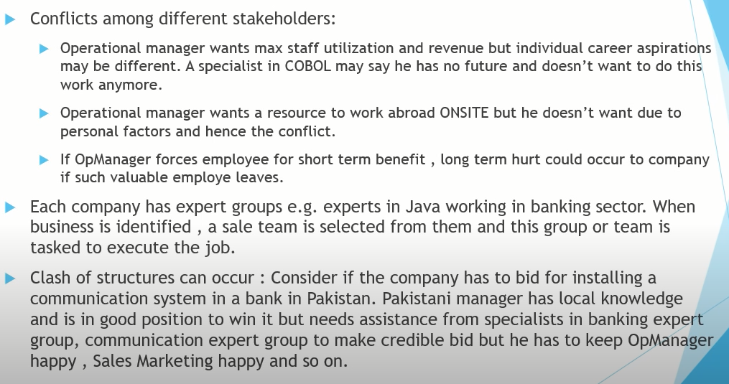
Operation Director
Notes:
Interplay of staff. Satisfy managers.

Slide 6
Technical Director
The Technical Director is responsible for:
quality management;
research and development;
• marketing at a technical level (e.g. arranging for staff to give papers at conferences, meetings, technical trainings);
• Technical training (as opposed to training in, say, project management or presentational skills, which are the responsibility of the personnel function).

Slide 7
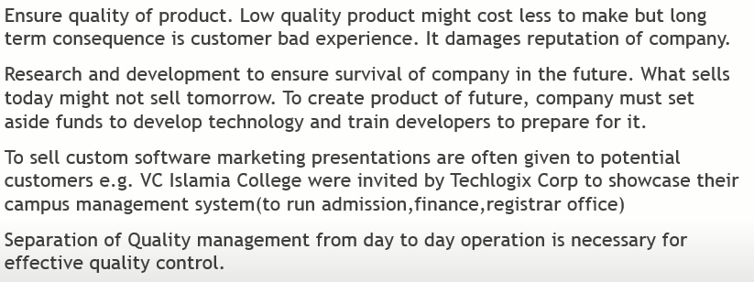

Technical Director
Conflict

Slide 8
Syniad’s Organizational structure Type
Functional division of responsibility
Geographical element ( represented by directors responsible for overseas operations)

Slide 9
Centralization vs Decentralization
In theory at least, staff have a sense of belonging to a group and regard their group manager as the manager who is permanently responsible for their career in the company.
In practice, because projects often require expertise from more than one group, staff often find themselves working on projects for groups other than the one to which they belong and the sense of group identity is diluted
In a company of the size of Syniad, the distinction between centralization and decentralization has little meaning. Centralized policies and procedures are widely used but they have usually been developed within one part of the company and have been adopted by general consent.

Slide 10
Management of Staff
When the company was small, with less than about 50 staff, there were few problems. The directors knew all the staff personally and most had been recruited through personal contacts.
Staff were loyal to the company and this loyalty showed itself in a willingness to work unpaid overtime when necessary and to maintain high technical standards regardless of the extent of supervision
The company’s ability to expand depends on its ability to recruit and retain staff; its reputation in the market place depends on the quality of its staff.
Directors put a lot of effort into keeping all employees informed about the company’s activities and were able to take a sympathetic attitude to any personal problems that arose
Company was not able to organize much training itself, it encouraged and was willing to pay for staff to go on training courses provided by other organizations

Slide 11
Management of Staff
As company grew directors were not able to build up the same level of personal relationships with the new staff and loyalty to the company diminished
New Employees vs Old Employees ….OUTSIDER
Staff Appraisals:employees’ achievements and contributions to the company were properly recorded;
staff knew what was expected of them and what they needed to achieve in order to gain promotion;
proper plans for training and career development were made and regularly reviewed;
employees were aware of the company’s opinion of their performance.
Employee’s are appraised and salary reviewed after every 6 months. Managers does this by (code reviews, deadline commitment, punctuality etc)
Notes:
There should be no wild swings/unstable business in company (more business less resources or more resources and less work)

Slide 12
Management of Staff
Despite the overall success of Syniad’s staff management, there are still perceived to be a number of difficult problems to be overcome:
• how to provide continuity of management as staff move from project to project; • how to exploit and foster group expertise (e.g. the collective expertise of the company’s six database experts) in an environment in which the members of the group are usually working on different projects; • how to maintain standards and company loyalty as the company continues to grow.
Notes:
There should be no wild swings/unstable business in company (more business less resources or more resources and less work)

Slide 13
Management of Staff
The biggest difficulty, however, in developing and pursuing a consistent and satisfactory personnel policy, is the unstable nature of the business.
Syniad lurches from the position in which it is desperate to recruit staff to service the contracts which it has, to the position in which it is desperate to get business in order to keep its staff on revenue earning work.
In either of these situations it is difficult to ensure that staff work on projects which are appropriate to their skills, their desires and their planned career development.
This is ultimately a consequence of the company’s under-capitalization.
Notes:
There should be no wild swings/unstable business in company (more business less resources or more resources and less work)

Slide 14
Producing the Budget
Staff in the company are divided into two categories
Technical or revenue earning staff
Non-revenue earning staff
Both require different capital to work.

Slide 15
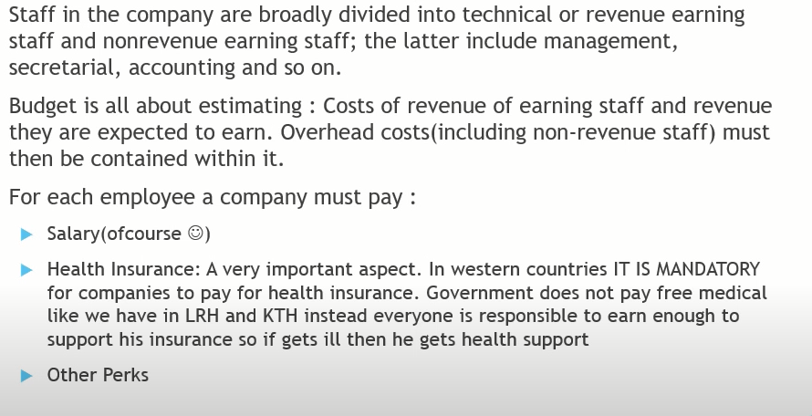
Producing the Budget

Slide 16
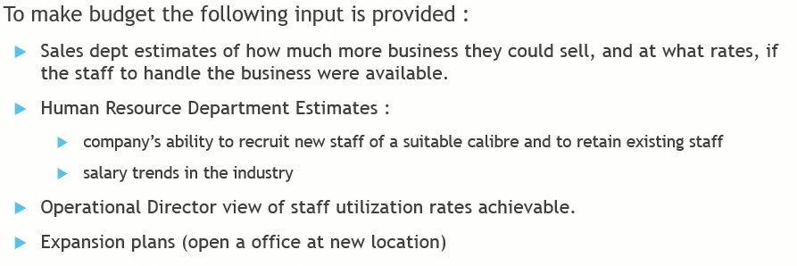
Producing the Budget

Slide 17
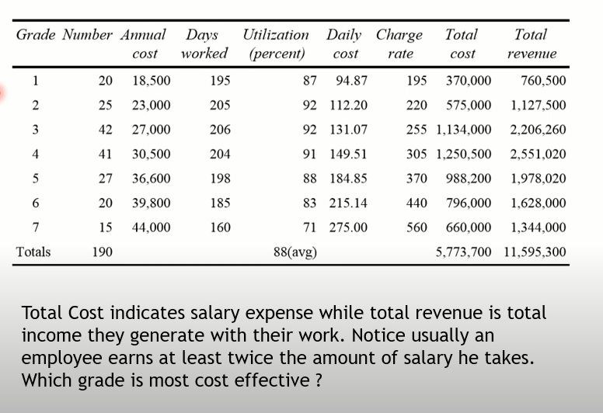

Slide 18
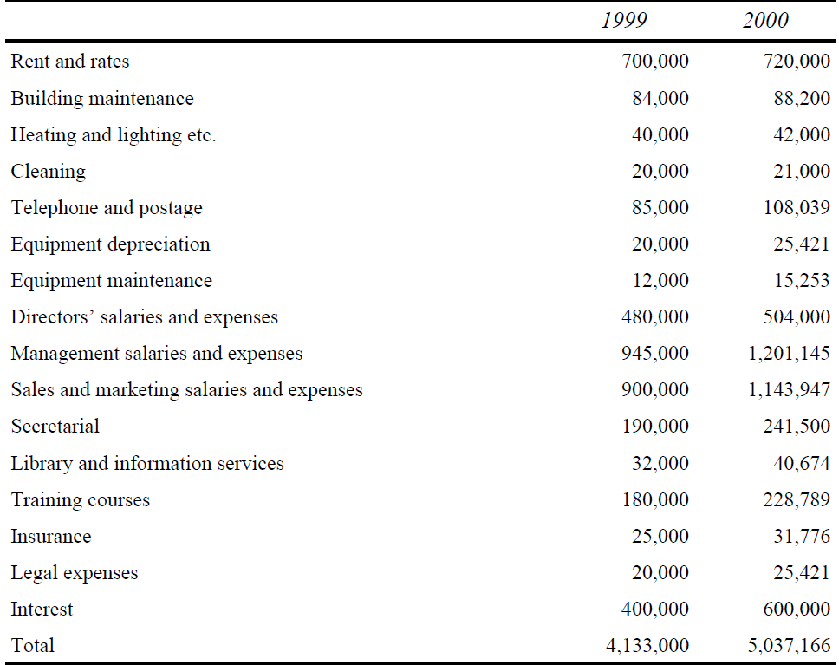
Producing the Budget

Slide 19
Monitoring Financial Performance
Monitoring Syniad’s performance against the budget should, in principle, be straightforward. Each month, the income and expenditure under the various heads are compared and, if significant deviations are observed, corrective action is taken. In practice, this simple procedure presents many difficulties.
Cost and revenue
Project costing
Sales

Slide 20
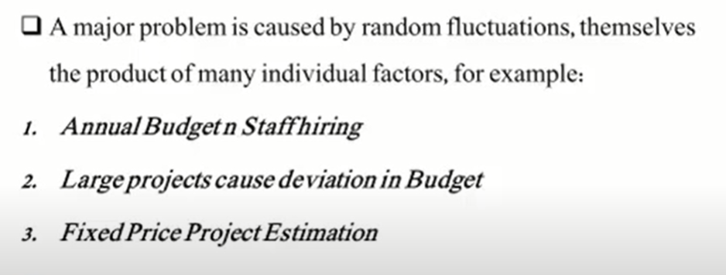
Costs and Revenue
Notes:
• The budget assumes that, over the twelve month period, staff will increase by a total of 30; in other words the excess of joiners over leavers will be 30. In the absence of any reason for believing otherwise, this will have been shown as a net monthly increase of 2.5 staff. However, while the budgeted figure of 30 may well prove to be correct, it is unlikely to follow this neat pattern; in some months there may be a net increase of seven or eight, while in other months there may be a net decrease.
• Large projects will cause significant deviations from the budget in various ways. The call for proposals for a large project will take several senior technical staff away from revenue earning work on to the preparation of the proposal; this may last for as much as a couple of months, or even longer. On average over the year, the utilization of that grade of staff may accord with the budget but it will be much lower for the period of proposal preparation. During a big project, the overall level of staff utilization may increase, because so many staff are continuously and fully employed on the project but the end of the project often sees staff becom-ing available at a rate greater than that at which they can be deployed on to other projects, thus adversely affecting utilization.
• In fixed price projects, revenue is accrued on the basis of the increase in the value of work in progress. Even the most conscientious of project managers will not normally re-estimate the whole project every month; rather, the increase in work in progress will be calculated monthly by applying a formula mechanically and, once every few months, the project will be re-estimated. The result of this is likely to be a hiccough (one way or the other) in the monthly revenue—it may even turn out to be negative.

Slide 21
Project Costing
Because of these difficulties in monitoring the overall performance of the company, Syniad also tries to monitor the financial performance of individual projects, through a project costing system.
The costs and revenue of each project are calculated each month and the cumulative gross margin (i.e. the difference between total costs and total revenue to date on the project) calculated as a percentage of the total revenue
Project managers complain that there is very little they can do about the costs.

Slide 22
Sales
Two reports are used for assessing and monitoring the sales position.
confirmed sales report
sales prospects report

Slide 23
Sales
The confirmed sales report shows, for each grade, the number of staff in that grade who are committed to contracts in each of the following twelve months and the total expected revenue from that grade in each month.
The sales prospects report shows, for each sales prospect, the potential value of the sale, its likelihood and the likely start date.

Slide 24
Long Term Planning
Strategic Planning for future
The ability to plan strategically and to achieve strategic objectives
Strategic planning in Syniad has two related aspects
The first is to identify appropriate long-term goals
To identify and formulate plans to overcome those problems which are inhibiting it from attaining these goals

Slide 25
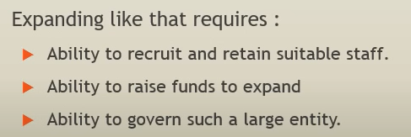
Long Term Planning
Why not go with the current structure?
Expansion plans
Recruit sales and management staff locally

Slide 26
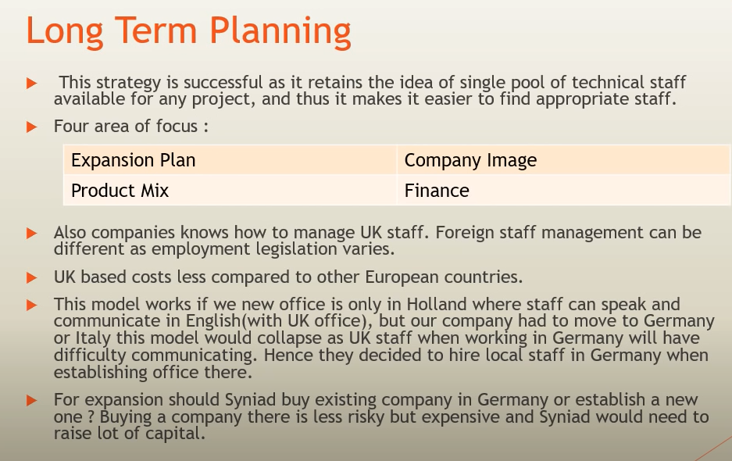

Slide 27
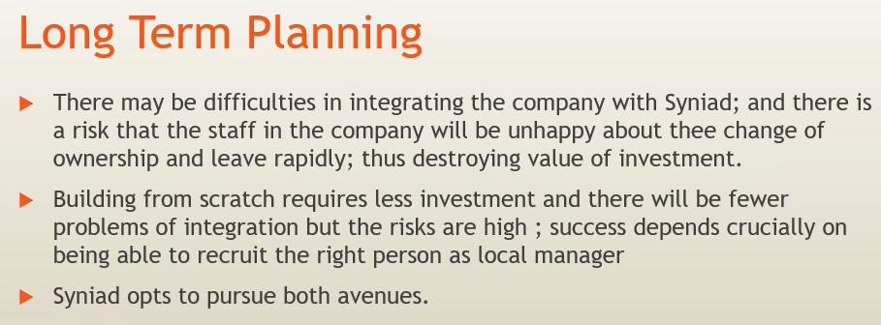

Slide 28
Long Term Planning
Company image
Product mix(fee based revenue vs package software)
Finance(under capitalization)

Slide 29
Conclusion
Syniad, despite its problems, is a successful and well-managed company. However, they need to go multi national
Do directors have the expertise to manage this transition or to run the resulting company?
However, it seems probable that Syniad has now reached a point where it can no longer thrive as a private company and its future must, inevitably, be very different from its past

